Slide 1
Leading Business Change in the Finance Function
Step 1 Create a sense of urgency

Slide 2
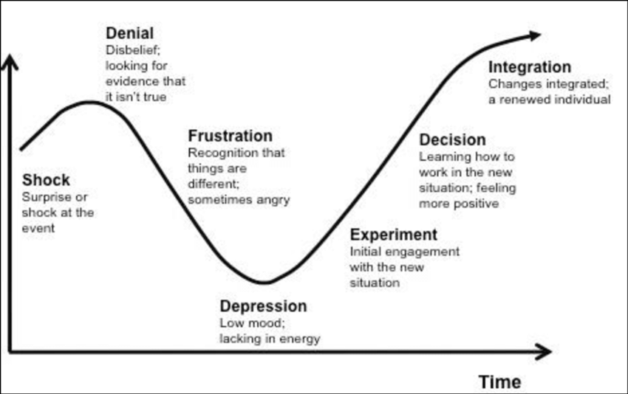
8 Steps to leading a finance transformation journey
Create a sense of urgency
Build a guiding coalition
Form a strategic vision
Enlist a volunteer army
Enable action by removing barriers
Generate short term wins
Sustain progress
Embed the changes
Steps 1-4 have a common enemy - Complacency

Slide 3
Nothing happens without a burning platform

Slide 4
What happens if there’s too much complacency?
Don’t get the extra effort needed
Cling to the status quo
Continuous improvement doesn’t happen
New strategies fail to get implemented well
Acquisitions aren’t assimilated properly
Downsizing doesn’t get to the least necessary expenses
Quality programmes become surface talk not real business substance

Slide 5
Where does complacency come from?
Complacency
Absence of a major visible crisis
Too many visible resources
Low overall performance standards
employees focussed on narrow functional goals
The wrong KPIs
Lack of customer feedback
kill the messenger culture
Human nature and capacity for denial
happy talk from senior management
But….how do you create urgency?

Slide 6
Create a crisis
Allow something to go wrong

Slide 7
Eliminate obvious examples of excess
Discretionary spend embargo

Slide 8
Set unachievable targets
Revenue
Profit
Productivity
Customer satisfaction
Output
Cycle times
Simply cant achieve these with BAU….Therefore something must change

Slide 9
More info to more employees
Make sure people know the score

Slide 10
Make your people talk to disgruntled customers
They cant hide from the truth!
This Photo by Unknown Author is licensed under CC BY-SA

Slide 11
Use consultants
This Photo by Unknown Author is licensed under CC BY-SA
Forces an external view and management discussion

Slide 12
Stop the happy talk
Tell it like it is in company communications

Slide 13
Future opportunities
Bombard people with info on what we’re missing out on

