Slide 1
Leading Business Change in the Finance Function
An Overview

Slide 2
3 Elements of Future Finance Functions
People
Processes
Enablers
Business Change
Objectives
Systems
These must come together to deliver a successful business change

Slide 3
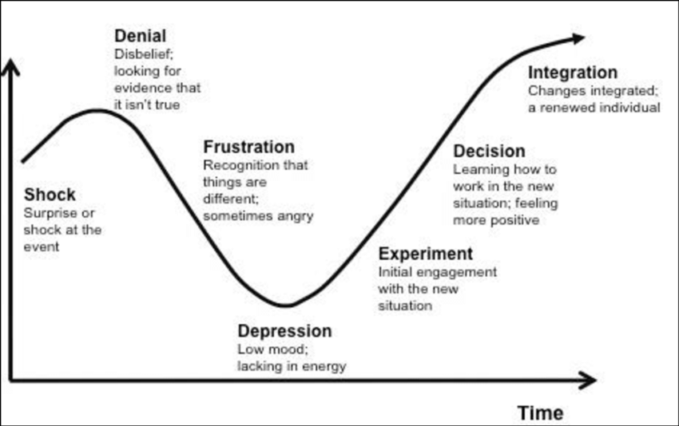
Understanding how people react to change is key
Denial:
Disbelief, looking for evidence it isn’t true
Integration:
Changes integrated; a renewed individual
Feelings
Decision:
Learning how to work in the new situation; feeling more positive
Frustration:
Recognition that things are different; sometimes angry
Shock:
Surprise or shock at the event
Experiment:
Initial engagement with the new situation
Depression:
Low mood; lacking in energy
So, how do you lead a successful finance transformation programme?

Slide 4
8 Steps to leading a finance transformation journey
Create a sense of urgency
Build a guiding coalition
Form a strategic vision
Enlist a volunteer army
Enable action by removing barriers
Generate short term wins
Sustain progress
Embed the changes
And communicate at every step, using every method available

