Slide 1
Future of finance functions
Transforming your finance processes
Where do you start?

Slide 2
Why Transform?
Traditional approach
New vision
Decision
support
40%
Transaction
processing
40%
Transaction
processing
60%
Decision
support
60%
Scorekeeper
Controlling
Measure results
Direction
Vertical management
Cost minimization
Cost & Revenue measures only
Efficiency
Internal focus
Number focused
Business partner
Influencing
Understand cost & value drivers
Consensus
Horizontal management
Value maximization
Cost & Revenue, balance sheet, cash flow
Effectiveness
Services focus
Customer and people focused

Slide 3
3 Simple steps to improving your finance processes
Simplify
Standardise
Automate

Slide 4
How do I start to simplify the process?
Understand the process
What are the steps?
Who is involved?
How long does it take?
Where are the bottlenecks?
Where is the waste?

Slide 5
Finance and Procurement Process
Finance and Procurement Processes
1. Purchase to Pay
2. Sales to Collection
3. Governance to Results
1.0 Purchase to pay
2.0 Sales to collection
3.0 Governance
to results
1.1 Create Requisition
1.2 Request for Quotes
1.3 Manage Contracts
1.4 Create Purchase Order
1.5 Create Goods Receipt
1.6 Process Invoice
1.7 Make Payments
1.8 Manage P2P master data
1.9 Manage Stock
1.10 Manage Catalogues
1.11 Manage Imprests
2.1 Maintain credit control policy
2.2 Create Sales Orders
2.3 Create Sales bills
2.4 Receipt income
2.5 Manage Debts
2.6 Maintain Master Data
3.1 Maintain Chart of Accounts
3.2 Manage Assets
3.3 Manage Revenue Budgets
3.4 Manage Capital Budgets
3.5 Manage The General Ledger
3.6 Manage Bank Accounts
3.7 Period & Year End closure
3.8 Manage Projects
3.9 In – Year budget management
3.10 Maintain master data
3.11 Measure Performance
3.12 Manage cash requirements
3.13 Manage Taxation
3.14 Risk Management / Insurance

Slide 6
Purchase to Pay
1. Purchase to Pay
1.1 Create
Requisition
1.2 Create
Purchase Order
1.3 Create Goods
Receipt
1.4 Manage Stock
1.5 Process Invoice
1.1.1 Identify requirement
1.1.2 Create EBP shopping cart (Requisition)
1.1.3 Approve EBP shopping cart
1.1.4 Create R/3 MM Requisition
1.1.5 Release R/3 MM Requisition (Approval)
1.5.1 Enter invoice through Logistics Invoice Verification
1.5.2 Enter direct FI-AP invoice
1.5.3 Process invoice through EBP electronically (TBC)
1.5.4 Handle Supplier invoice enquiries
1.5.5 Handle Invoice rejections and follow-ups with suppliers
1.2.1 Create purchase order from EBP (Automatically)
1.2.2 Create Purchase order with reference to Requisition
1.2.3 Create Purchase Order directly
1.2.4 Release Purchase Order (Approval)
1.2.5 Send Purchase Order to Suppliers
1.2.6 Manage Purchase Orders
1.3.1 Create Confirmation (EBP shopping cart)
1.3.2 Create Goods receipt for Purchase Order
1.3.3 Create Service Entry for Purchase Order
Not expected to be in scope. Surrey do not have a County-wide stores requirement. Solution here is expected to be simple

Slide 7
Purchase to Pay - continued
1. Purchase to Pay
1.6 Travel and
Expense processing
1.7 Manage Imprest
Reimbursements
1.8 Make Payments
1.9 Request for
Quote
1.6.1 Complete Claim form
1.6.2 Process Claim Form
1.6.3 Approve Claim Form
1.6.4 Compare receipts to Claims
1.6.5 Settle Travel Claims
1.6.5 Process Payments
1.6.6 Handle Employee Queries
1.6.7 Manage Expense Policy and reclaim amounts
1.6.8 Provide Expense Reporting
1.7.1 Complete Claim Form
1.7.2 Approve Claim Form
1.7.3 Process Claim Form
1.7.4 Handle Establishment queries
1.7.5 Make Payments
1.7.6 Reconcile local Bank Accounts
1.8.1 Manage Payments (BACS/Cheques/CHAPS/etc)
1.8.2 Make payments to business partners
1.8.3 Carry out Cheque Administration
1.8.4 Stop Payments
1.8.5 Handle Supplier queries
1.8.6 Late Payment calculations and reports
1.9.1 Build a request for quote
1.9.2 Send Request for Quote
1.9.3 Evaluate Quotes
1.10 Contracts Process
1.11 Maintain
catalogues
1.10.1 Decide procurement process
1.10.2 Develop Specification
1.10.3 Advertise Requirement
1.10.4 Process Bids
1.10.5Approve Vendor
1.10.6 Negotiate Contract
1.10.7 Award Contract
1.10.8 Monitor / Manage Contract
1.11.1 Identify Suppliers
1.11.2 Prepare supplier adoption packs
1.11.3 Take suppliers through adoption process
1.11.4 Load catalogue data
1.11.5 Maintain catalogue data

Slide 8
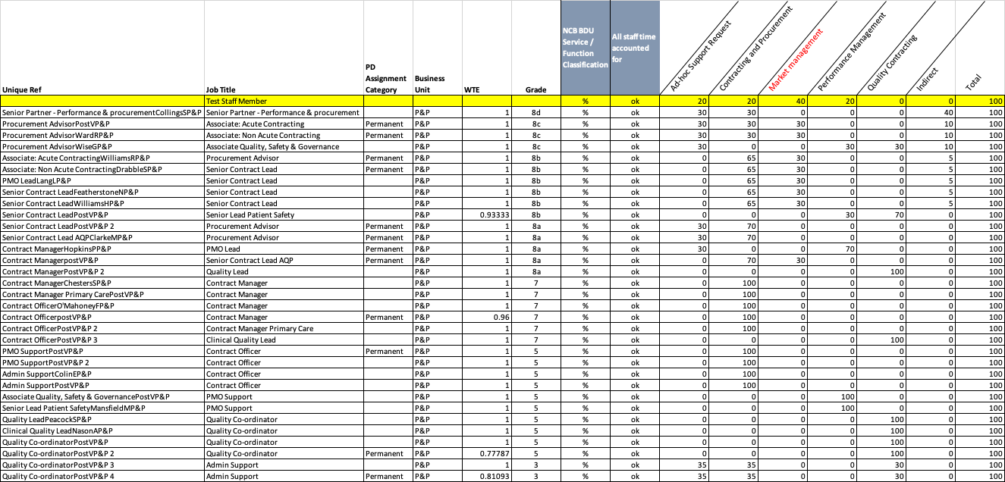
Understand how people spend their time

Slide 9
Understand in more detail - Draw a process map
Process Name: Variable budget release
MFM
Approve the business case
Can this be contained in overall budget
Allocate contingency?
Don’t spend
No
Yes
No
No
Escalate overspend
Yes
Yes
F.Mgr&SLT Member
contain in SLT member’s budget?
No
Agree business case for additional funding
Yes
Fin Team
Prepare analysis
Reallocate budgets & release / recall funds as appropriate
Release contingency to allow budget holder to place PO
Release funds to cover requirements in immediate 3 months
Acc Panel
No
Yes
Review YTD spend & plans
Forecast outturn changed?
contain in local budget?
Yes
No
Budget Holder
Update forecasts
Place orders in line with budget
9

Slide 10
Understand the bottlenecks
Process Name: Variable budget release
MFM
Approve the business case
Can this be contained in overall budget
Allocate contingency?
Don’t spend
No
Yes
No
No
Escalate overspend
Yes
Yes
F.Mgr&SLT Member
contain in SLT member’s budget?
No
Agree business case for additional funding
Yes
Fin Team
Prepare analysis
Reallocate budgets & release / recall funds as appropriate
Release contingency to allow budget holder to place PO
Release funds to cover requirements in immediate 3 months
Acc Panel
No
Yes
Review YTD spend & plans
Forecast outturn changed?
contain in local budget?
Yes
No
Budget Holder
Update forecasts
Place orders in line with budget
10

Slide 11
What are the 7 wastes?

