Slide 1
Future of finance functions
Investment Appraisal

Slide 2
The CFO, the finance function, and investment appraisal
Why do you need a business case?
What should a business case contain?
How should the CFO and his team be involved in appraisal?

Slide 3
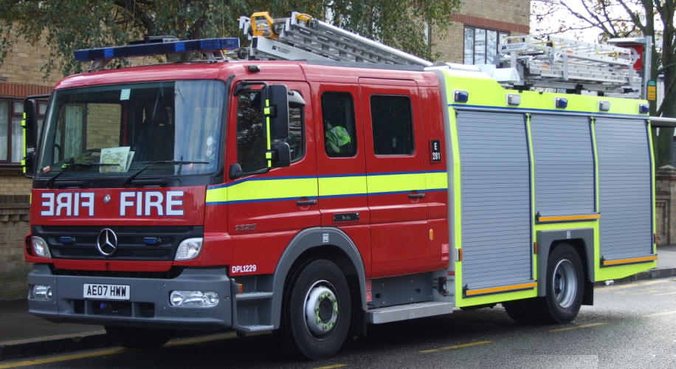
What happens when you invest without a business case?

Slide 4
Controlling the project lifecycle
“A&D Consultancy”
Detailed Analysis & Planning
Delivery
In Service
Initial Concept
Concept Analysis & Development
Detailed Analysis & Planning
Detailed Design & Development
Business Implementation
Benefits Tracking
0
1
2
3
4
0
Approval to invest in resource in developing concept further
1
Approval of concept and resource required to develop into a project
2
Approval to
implement project as described in PID and BC
3
Approval to rollout designed solution
4
Approval of successful implementation and permission to close project

Slide 5
The CFO, the finance function, and investment appraisal
Why do you need a business case?
What should a business case contain?
How should the CFO and his team be involved in appraisal?

Slide 6
A basic structure for a business case
The 5 case model
  Strategic case ………..does it fit in with our business objectives?
  Economic case……….what options do I have? Which gives best VfM?
  Commercial case…......how am I going to buy it?
  Financial case…………Is it affordable?
  Management case……..Is it practical to do this?

Slide 7
You should demonstrate you’ve thought through all the options.
Organisational scope options – choices in terms of coverage (The what)
Service solution options – choices in terms of solution (the how)
Service delivery options- choices in terms of delivery (the who)
Implementation options – choices in terms of timescale (the when)
Funding options – choices in terms of finance and funding (the money)

Slide 8
The business case process in the public sector
PBC
OGC
OBC
FBC
OGC
OGC
OGC
OGC
OGC
GW1
GW1
GW2
GW2
GW3
GW3
Strategic Fit
Strategic Fit
Strategic Fit
Identify
Detailed
business
Economic
assessment
Economic
Undertake
Economic
Commence
need &
Appraisal
of
Appraisal
procurement
Appraisal
implementation
options
options
Affordability
Affordability
Affordability
Appraisal
Appraisal
Appraisal
Key:
Detailed
Commercial
Commercial
Commercial
Completion
Appraisal
Appraisal
Appraisal
Outline
Completion
Deliverability
Deliverability
Deliverability
Updated
Appraisal
Appraisal
Appraisal
Typical
In
In
Out
Out
In
In
Out
Out
In
In
Out
Out
* Exceptionally more
no. of
than one option
5
may be carried forward
5
-
-
7
7
3
3
-
-
4
4
3
3
-
-
4
4
1*
1*
1*
1*
1
options
1
at OBC

Slide 9
The CFO, the finance function, and investment appraisal
Why do you need a business case?
What should a business case contain?
How should the CFO and his team be involved in appraisal?

Slide 10


Slide 11
The CFO needs to be involved if
The project is above £x000’s
Unless it is:
  High risk
  Involves multiple organisations
  Mission critical
  Novel
  Reputational risk

