Slide 1
Cryptocurrencies for
(Grow)CFOs
Dr. Maria Grazia Vigliotti
Sandblocks Consulting

Slide 2
Sandblocks Consulting
Education
Conference & Events
Training
Chief Editor - Frontiers in Blockchain
Book: Blockchain for Executives
Strategy
Member ISO TC 307
Advisor to companies
Research projects
Proof of concepts
Hackathons
Growth
Smart Contracts
Security Audits
Initial Coin Offerings
Platforms building
Accelerate adoption
Notes:
I am the founder and director of this company- we provide several services to companies around the world.
We provide training both for executives and technical (and how to programme the blockchain)
I am an invited speaker at events and conferences around the world
I am also the Chief Editor the Journal “Frontiers on Blockchain “Section Smart contracts”” – this is a peer-reviewed Journal that collects original articles from both academic and practioners
Research Collaboration with Imperial College, the Centre for Research on Cryptocurrency
Research Collaboration with the UCL Centre for Blockchain Technology, Prof. Paolo Tasca we wrote an article what is going to be published on the Journal of Digital Banking with the title: Risks and Challenges of Initial
Coin offerings
I am also am writing a book on blockchain which will be published in February 2019 – The executive “Guide to Blockchain”
We provide strategic advice to company regarding blockchain at all levels:
Research and analysis projects: is blockchain good for your industry or business case for specific applications
We accelerate adoption by producing proof of concepts and development of in-house capabilities
We take part and organize hackathons – one in Accra and one in Lagos
We help company to develop thi
We help companies to growth:
Delivery security by design smart contracts
We Audit smart contract
We help companies in the project Initial Coin Offerings

Slide 3
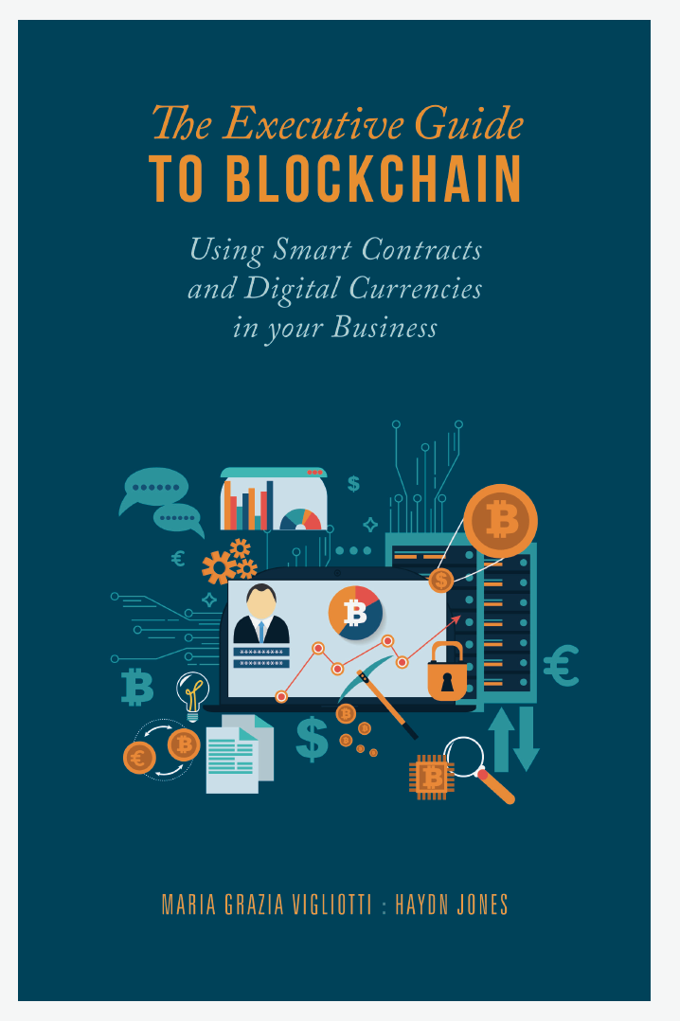
An Indispensable Guide
Jargon-free explanation of all aspects of blockchain
An indispensable read for anyone who understands the importance of "Skating to where the puk is going to be!" I found the content to be very thorough and easily digestible, admittedly some chapters required a strong coffee but are well worth the time investment.
Available from Amazon https://www.amazon.co.uk/Executive-Guide-Blockchain-Contracts-Currencies/dp/3030211061

Slide 4

What are Cryptocurrencies?
Cryptocurrencies are a form of digital assets that exist in the digital world alone
Assets can be exchanged for real-world goods or other digital assets
No underlying national economy
No central bank regulating the currency
Computing experts run the show
Bitcoin is the most popular cryptocurrency to date
Notes:
Cryptocurrency is a type of digital asset used as a medium of exchange. The most famous one is Bitcoin. Other common terms for cryptocurrencies are digital tokens or digital assets. They are all stored in distributed ledgers called blockchains.
There is no physical counterpart
There is no governor that sets the economic policy, or sets interests rates, or sets set the supply, or injects more money when the market it illiquid.
CC can be exchanged for good and services, and can be used as medium of exchange.
Cryptocurrency is a type of digital asset used as a medium of exchange. The most famous one is Bitcoin. Other common terms for cryptocurrencies are digital tokens or digital assets. They are all stored in distributed ledgers called blockchains. Each blockchain has its own digital token. In the case of Bitcoin, it is the Bitcoin token. Other examples are Ethereum, Litecoin, Monero, Dash, Zcash, etc. Each digital coin has its properties and functions. This tutorial will focus on Bitcoin but could be used for any other cryptocurrency.

Slide 5
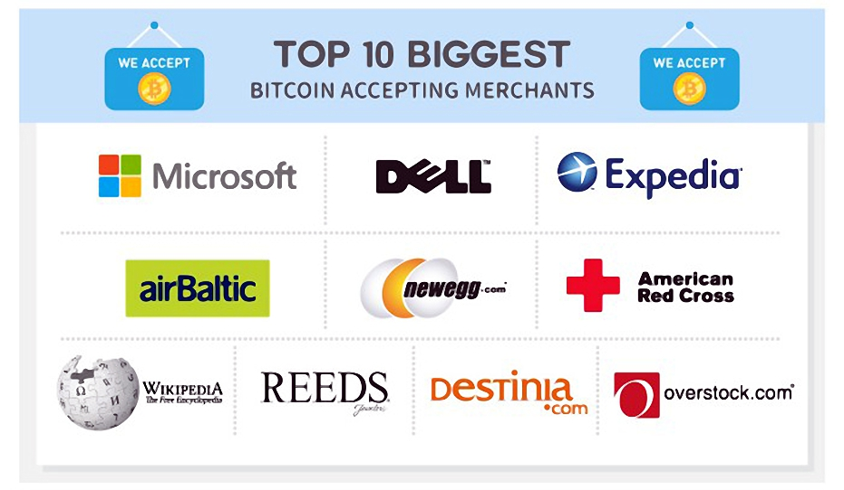

Paying with BTC
  Subway
  Save the Children (charities)
  Whole Food (Amazon)
  Badoo (online dating service)
  Online donations
  Virgin Galactic
  https://spendabit.co/

Slide 6


Key Concepts
Consensus: independent validation among multiple parties
Secure chain of data: transparency and auditability
Transactions: transfer of ownership of data, assets etc.

Slide 7
What is a Blockchain?
A distributed ledger of secure chronologically ordered transactions that:
Does not belong to anyone
Requires a consensus mechanism to be updated
Can be updated with append-only operations (persistent)
Is immutable – historical transactions cannot be changed (unless 51% agree to the change)
Notes:
Let’s think a moment w hy this is not a google drive-
If I put a google drive, and via email I invite everyone would that constitute a blockchain?

Slide 8
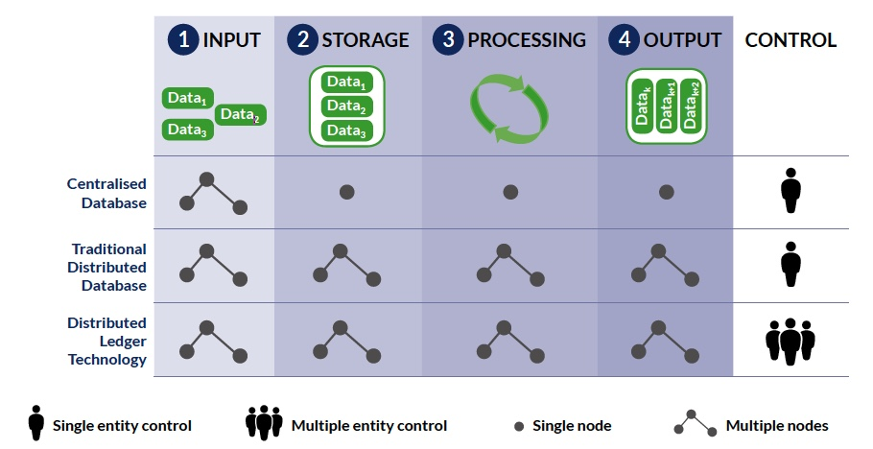
Blockchain

Slide 9
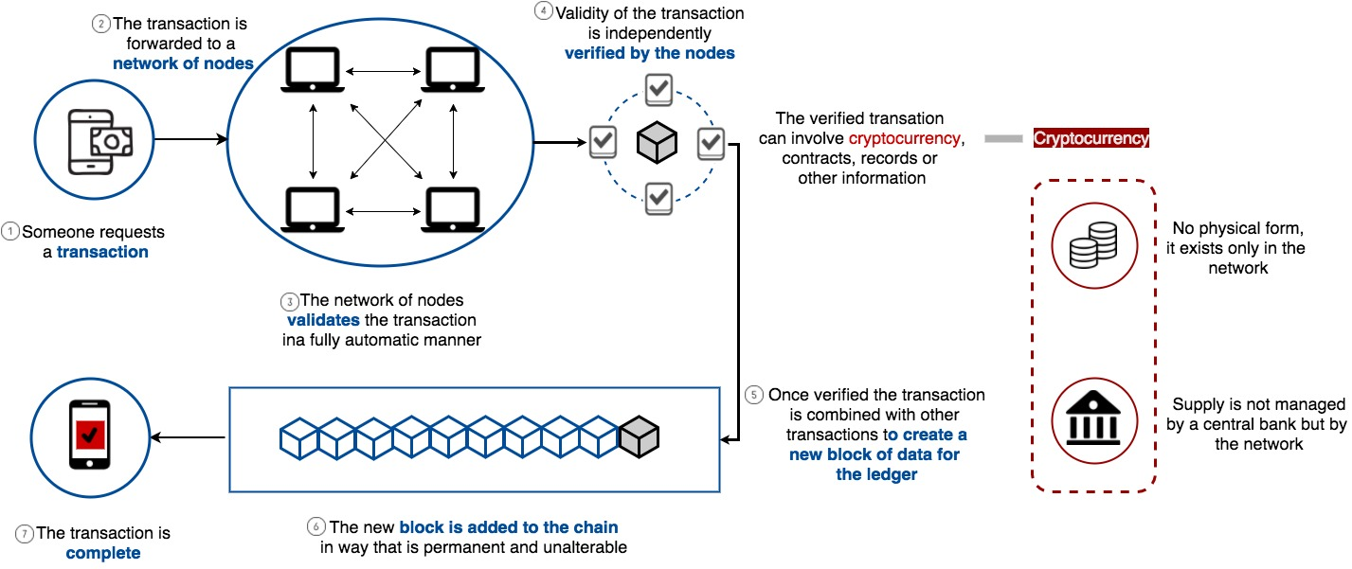
How Cryptocurrencies Work

Slide 10
Legal
Side
(Data source: The Law Library of Congress, https://www.loc.gov/law/help/cryptocurrency/ world-survey.php).

